Slide 1
Exploratory Data Analysis and Data Visualization
MCB 293S:
Foundations of Biostatistical Practice
Week 1
Kelly Street
PhD Candidate
Division of Biostatistics
Dr. Sandrine Dudoit
Department of Statistics
Division of Biostatistics

Slide 2


Logistics & Resources
Download
R: cran.r-project.org
RStudio: www.rstudio.com
Schedule
Lecture: Tuesday, 5-6pm, 106 Stanley
Lab: Wednesday, 5-6pm, 122 Barrows
Course website
github.com/kstreet13/mcb293s
Resources
Diya’s tutorials: github.com/diyadas/tutorials
RStudio Cheat Sheets: rstudio.com/resources/cheatsheets/
Quick-R Tutorial: https://www.statmethods.net/r-tutorial/index.html
MCB 293S
Exploratory
Data Analysis
Data Visualization
Week 1

Slide 3
Foundations of Biostatistical Practice
Data is everywhere.
Every new tool collects more data than the one before it. Quantitative skills are more fundamental to scientific research than ever before.
Science and Uncertainty
We should be as clear as possible about what we do and do not know. Statistics can help with that; it is how we quantify our uncertainty.
Terminology
Biostatistics, (applied) statistics, data science, computational biology?
MCB 293S
Exploratory
Data Analysis
Data Visualization
Week 1

Slide 4
Exploratory Data Analysis
What to do when you get a new dataset

Slide 5
Exploratory Data Analysis
Identify key aspects
Variables, types, missing data, sampling units, multiple parts
Eye Color
Height
Weight
Age
1
2
3
4
5
6
7
8
MCB 293S
Exploratory
Data Analysis
Data Visualization
Week 1

Slide 6
Exploratory Data Analysis
Age
Identify key aspects
Variables, types, missing data, sampling units, multiple parts
Summarize the basics
Sample size, levels, feature distributions
Height
Eye Color
MCB 293S
Exploratory
Data Analysis
Data Visualization
Week 1

Slide 7
Exploratory Data Analysis
Identify key aspects
Variables, types, missing data, sampling units, multiple parts
Summarize the basics
Sample size, levels, feature distributions
Explore in depth
Relationships, shape, clusters, use prior knowledge
Age
Height
Height
Weight
Eye Color
MCB 293S
Exploratory
Data Analysis
Data Visualization
Week 1

Slide 8
Example in R
R contains several built-in datasets. We’ll practice on the Iris flower data.
Input:
> iris
Output:
...
138 6.4 3.1 5.5 1.8 virginica
139 6.0 3.0 4.8 1.8 virginica
140 6.9 3.1 5.4 2.1 virginica
141 6.7 3.1 5.6 2.4 virginica
142 6.9 3.1 5.1 2.3 virginica
143 5.8 2.7 5.1 1.9 virginica
144 6.8 3.2 5.9 2.3 virginica
145 6.7 3.3 5.7 2.5 virginica
146 6.7 3.0 5.2 2.3 virginica
147 6.3 2.5 5.0 1.9 virginica
148 6.5 3.0 5.2 2.0 virginica
149 6.2 3.4 5.4 2.3 virginica
150 5.9 3.0 5.1 1.8 virginica
MCB 293S
Exploratory
Data Analysis
Data Visualization
Week 1

Slide 9
Example in R
R contains several built-in datasets. We’ll practice on the Iris flower data.
> head(iris)
Sepal.Length Sepal.Width Petal.Length Petal.Width Species
1 5.1 3.5 1.4 0.2 setosa
2 4.9 3.0 1.4 0.2 setosa
3 4.7 3.2 1.3 0.2 setosa
4 4.6 3.1 1.5 0.2 setosa
5 5.0 3.6 1.4 0.2 setosa
6 5.4 3.9 1.7 0.4 setosa
MCB 293S
Exploratory
Data Analysis
Data Visualization
Week 1

Slide 10
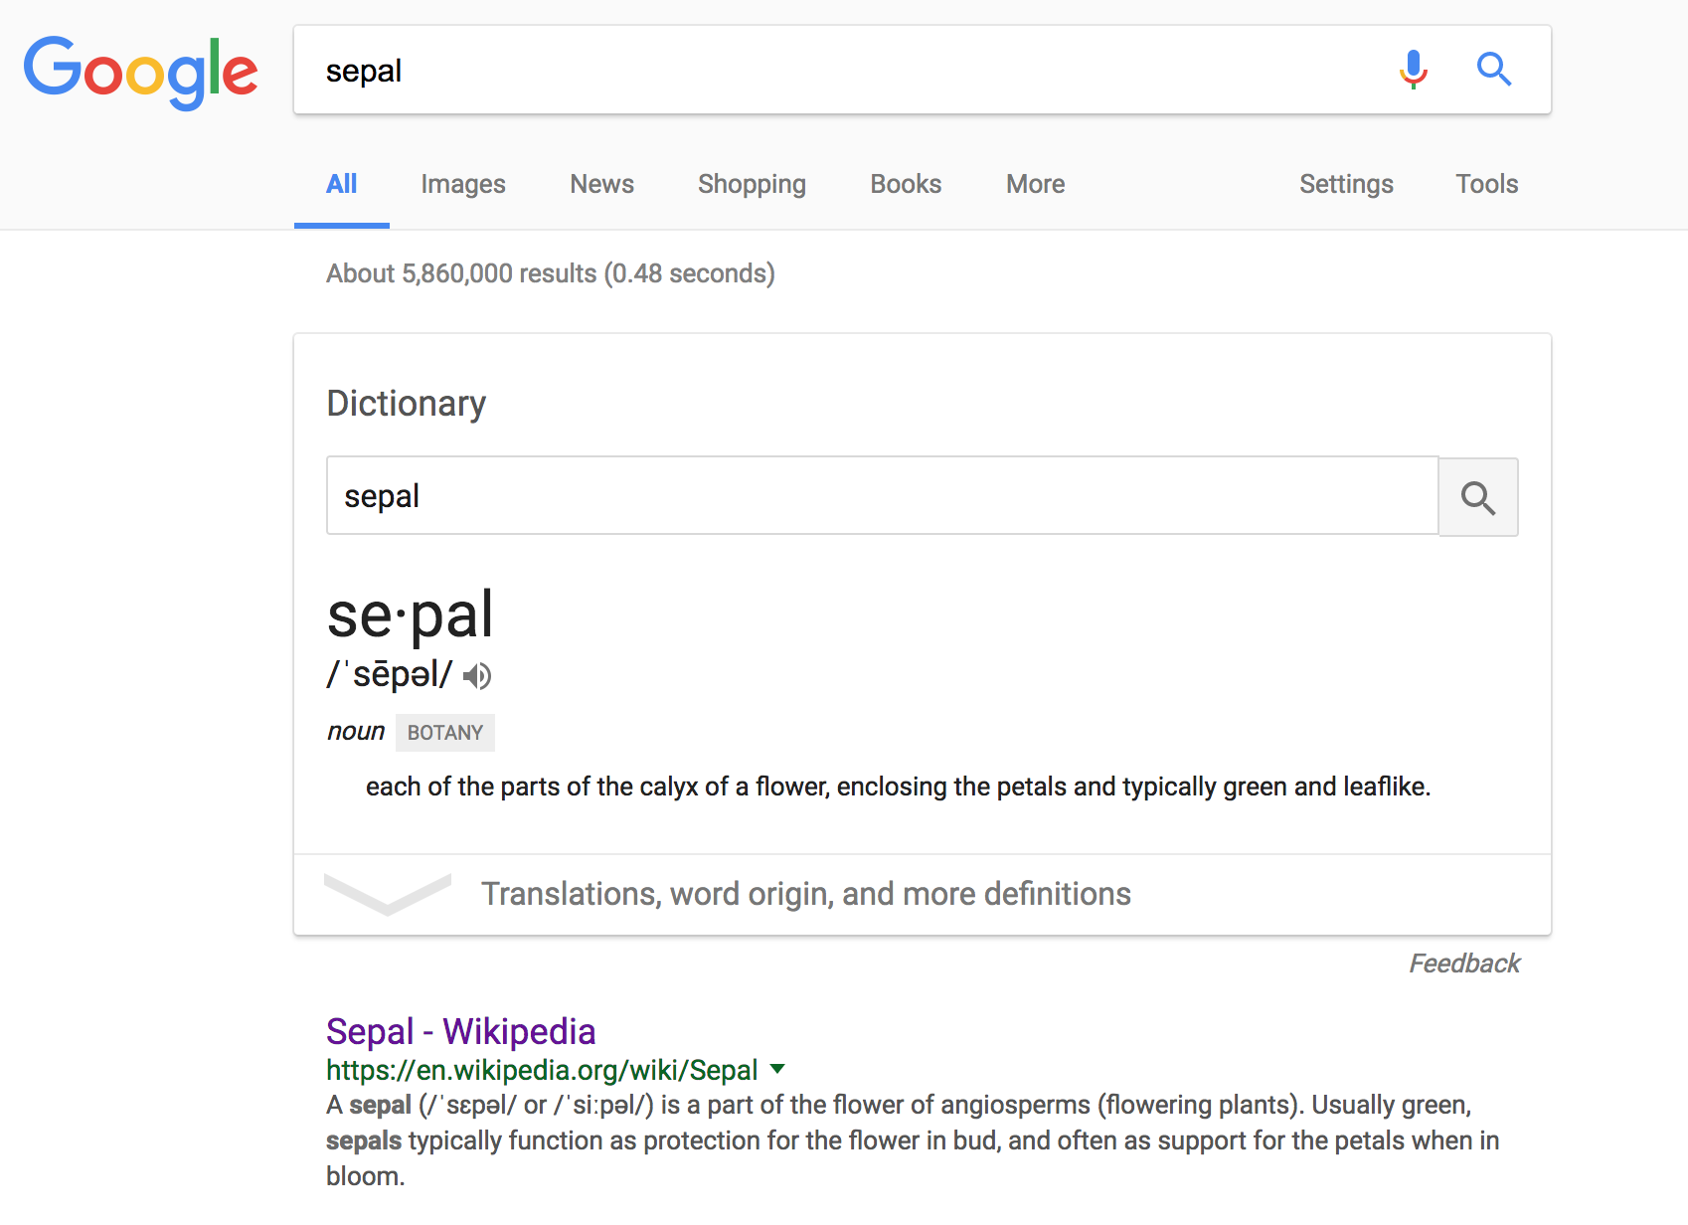
Example in R (mostly)
MCB 293S
Exploratory
Data Analysis
Data Visualization
Week 1

Slide 11
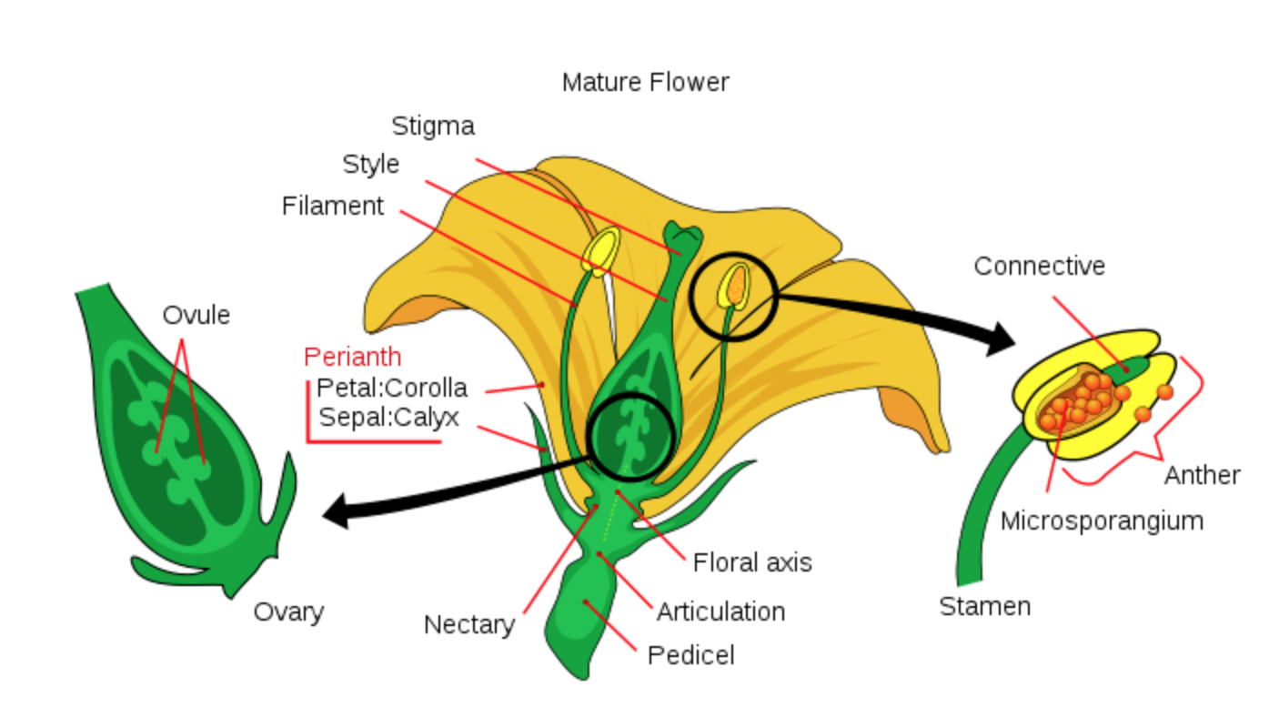
Example in R (mostly)
By Mariana Ruiz LadyofHats - Own work, Public Domain, https://commons.wikimedia.org/w/index.php?curid=2273307
MCB 293S
Exploratory
Data Analysis
Data Visualization
Week 1

Slide 12
Example in R
> head(iris)
Sepal.Length Sepal.Width Petal.Length Petal.Width Species
1 5.1 3.5 1.4 0.2 setosa
2 4.9 3.0 1.4 0.2 setosa
3 4.7 3.2 1.3 0.2 setosa
4 4.6 3.1 1.5 0.2 setosa
5 5.0 3.6 1.4 0.2 setosa
6 5.4 3.9 1.7 0.4 setosa
> class(iris)
[1] "data.frame"
This is a very common way to store data in R.
MCB 293S
Exploratory
Data Analysis
Data Visualization
Week 1

Slide 13
Example in R
How many flowers do we have?
> nrow(iris)
[1] 150
MCB 293S
Exploratory
Data Analysis
Data Visualization
Week 1

Slide 14
Example in R
What’s up with the “Species” variable?
> iris$Species
[1] setosa setosa setosa setosa setosa
[6] setosa setosa setosa setosa setosa
[11] setosa setosa setosa setosa setosa
[16] setosa setosa setosa setosa setosa
[21] setosa setosa setosa setosa setosa
[26] setosa setosa setosa setosa setosa
...
[121] virginica virginica virginica virginica virginica
[126] virginica virginica virginica virginica virginica
[131] virginica virginica virginica virginica virginica
[136] virginica virginica virginica virginica virginica
[141] virginica virginica virginica virginica virginica
[146] virginica virginica virginica virginica virginica
Levels: setosa versicolor virginica
MCB 293S
Exploratory
Data Analysis
Data Visualization
Week 1

Slide 15
Example in R
What’s up with the “Species” variable?
> class(iris$Species)
[1] "factor"
This is how R typically stores categorical data.
MCB 293S
Exploratory
Data Analysis
Data Visualization
Week 1

Slide 16
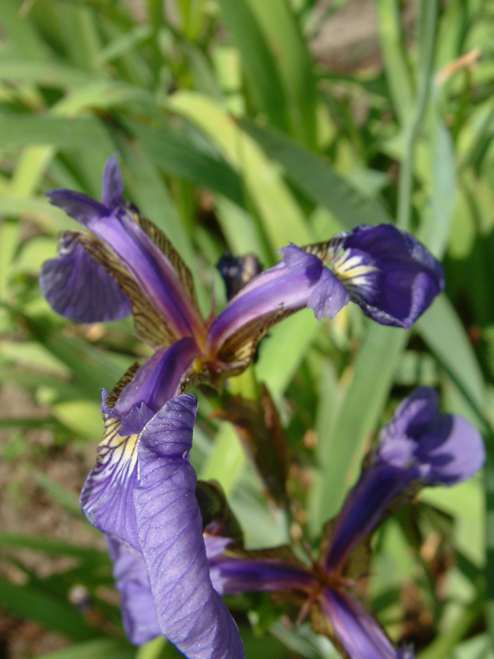
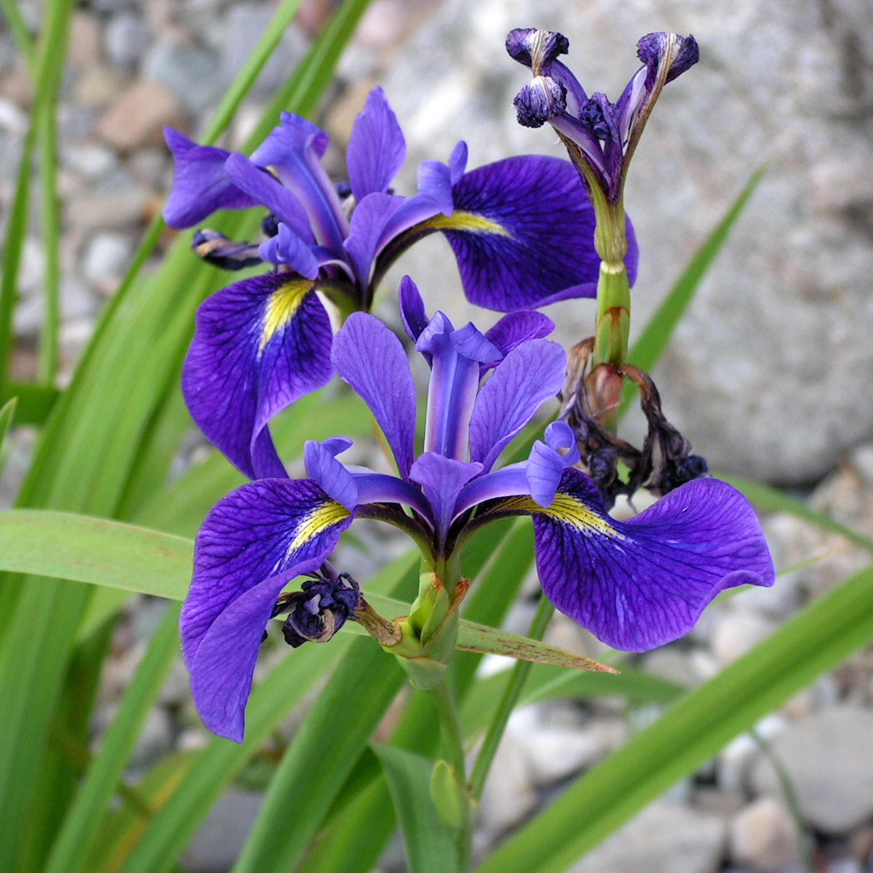
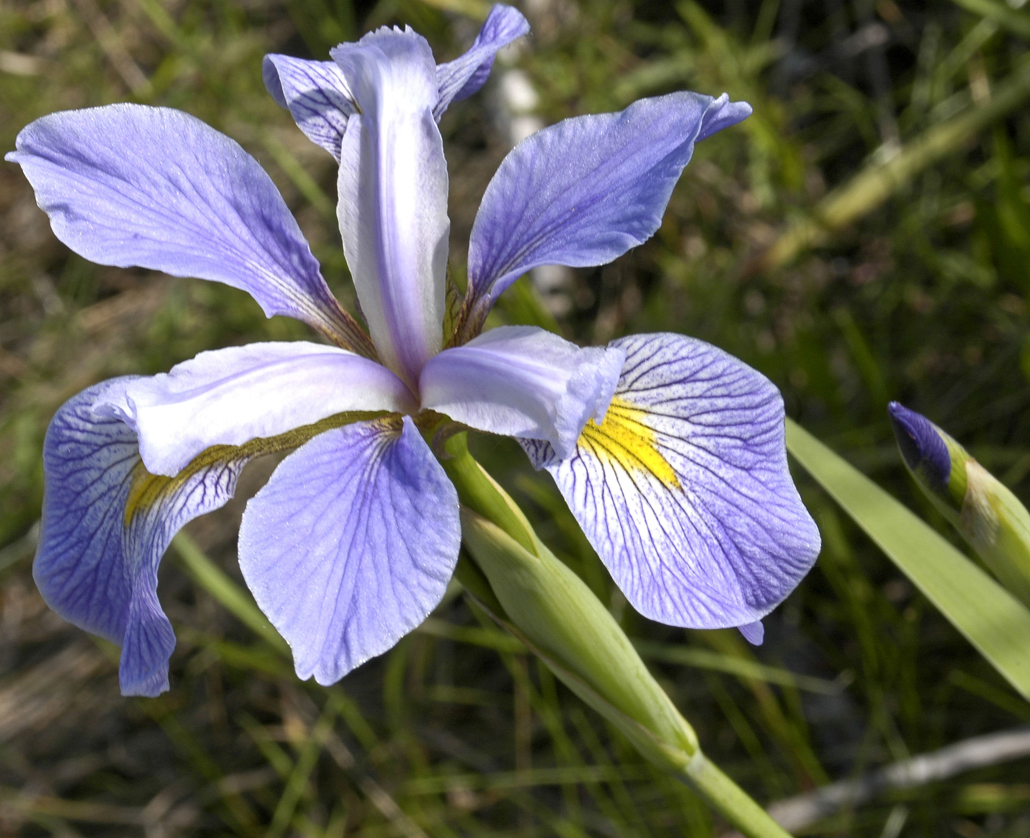
Example in R
How many of each species do we have?
> table(iris$Species)
setosa versicolor virginica
50 50 50
CC BY-SA 3.0, https://commons.wikimedia.org/w/index.php?curid=170298
By D. Gordon E. Robertson - Own work, CC BY-SA 3.0, https://commons.wikimedia.org/w/index.php?curid=10227368
By Frank Mayfield - originally posted to Flickr as Iris virginica shrevei BLUE FLAG, CC BY-SA 2.0, https://commons.wikimedia.org/w/index.php?curid=9805580
MCB 293S
Exploratory
Data Analysis
Data Visualization
Week 1

Slide 17
Example in R
What do the numerical variables look like?
> mean(iris$Sepal.Length)
[1] 5.843333
> mean(iris$Sepal.Width)
[1] 3.057333
> mean(iris$Petal.Length)
[1] 3.758
> mean(iris$Petal.Width)
[1] 1.199333
MCB 293S
Exploratory
Data Analysis
Data Visualization
Week 1

Slide 18
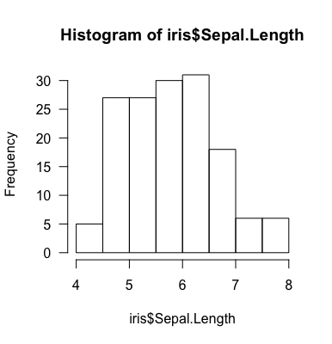
Example in R
What do the numerical variables look like?
> hist(iris$Sepal.Length)
MCB 293S
Exploratory
Data Analysis
Data Visualization
Week 1

Slide 19
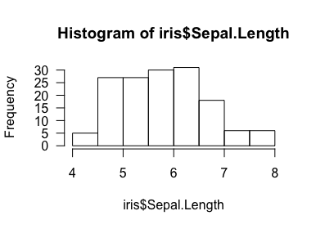
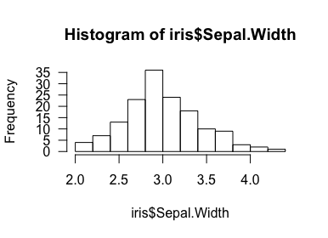
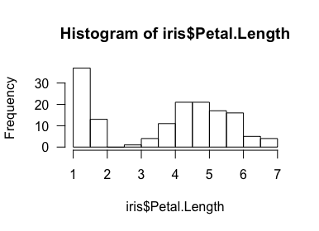
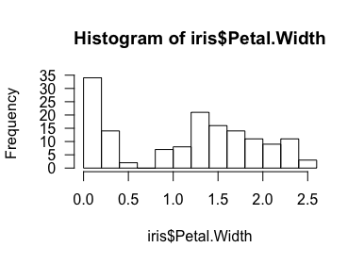
Example in R
MCB 293S
Exploratory
Data Analysis
Data Visualization
Week 1

Slide 20
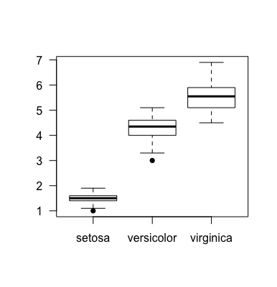
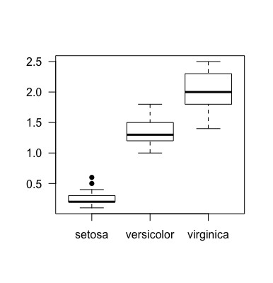
Example in R
Petal length and width appear to be bimodal.
> boxplot(Petal.Length ~ Species,
data = iris)
> boxplot(Petal.Width ~ Species,
data = iris)
MCB 293S
Exploratory
Data Analysis
Data Visualization
Week 1

Slide 21
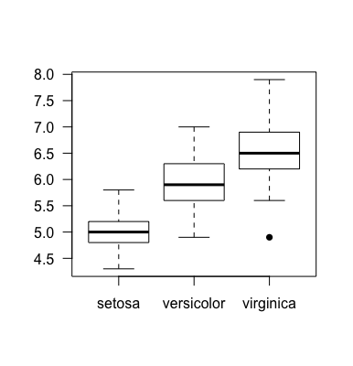
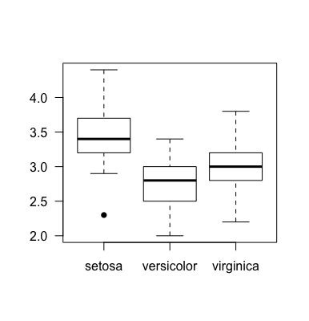
Example in R
What about sepal length and width?
> boxplot(Sepal.Length ~ Species,
data = iris)
> boxplot(Sepal.Width ~ Species,
data = iris)
MCB 293S
Exploratory
Data Analysis
Data Visualization
Week 1

Slide 22
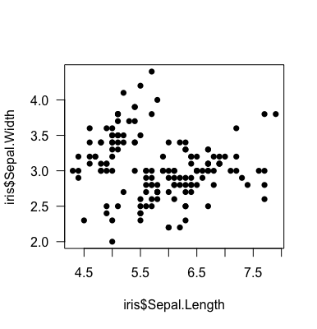
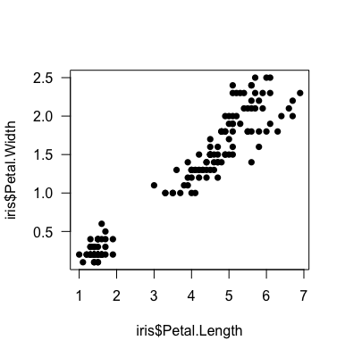
Example in R
The paired features (sepal length/width, petal length/width) seem like they should be correlated.
> plot(iris$Sepal.Length,
iris$Sepal.Width)
> plot(iris$Petal.Length,
iris$Petal.Width)
MCB 293S
Exploratory
Data Analysis
Data Visualization
Week 1

Slide 23
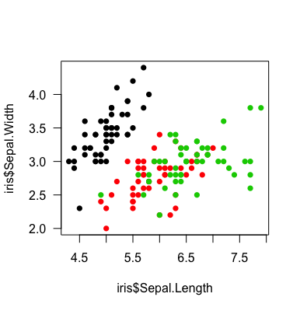
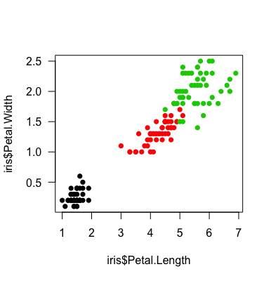
Example in R
How do these relate to species?
> plot(iris$Sepal.Length,
iris$Sepal.Width,
col = iris$Species)
> plot(iris$Petal.Length,
iris$Petal.Width,
col = iris$Species)
MCB 293S
Exploratory
Data Analysis
Data Visualization
Week 1

Slide 24
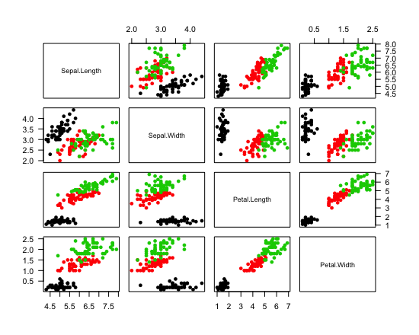
Example in R
> pairs(iris[,1:4], col = iris$Species)
MCB 293S
Exploratory
Data Analysis
Data Visualization
Week 1

Slide 25
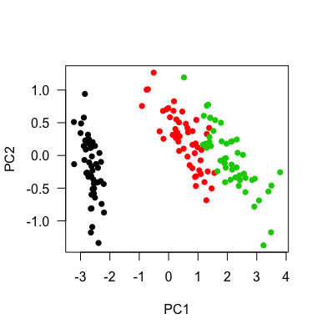
Example in R
> pca <- prcomp(iris[,1:4])
> plot(pca$x, col = iris$Species)
MCB 293S
Exploratory
Data Analysis
Data Visualization
Week 1

Slide 26
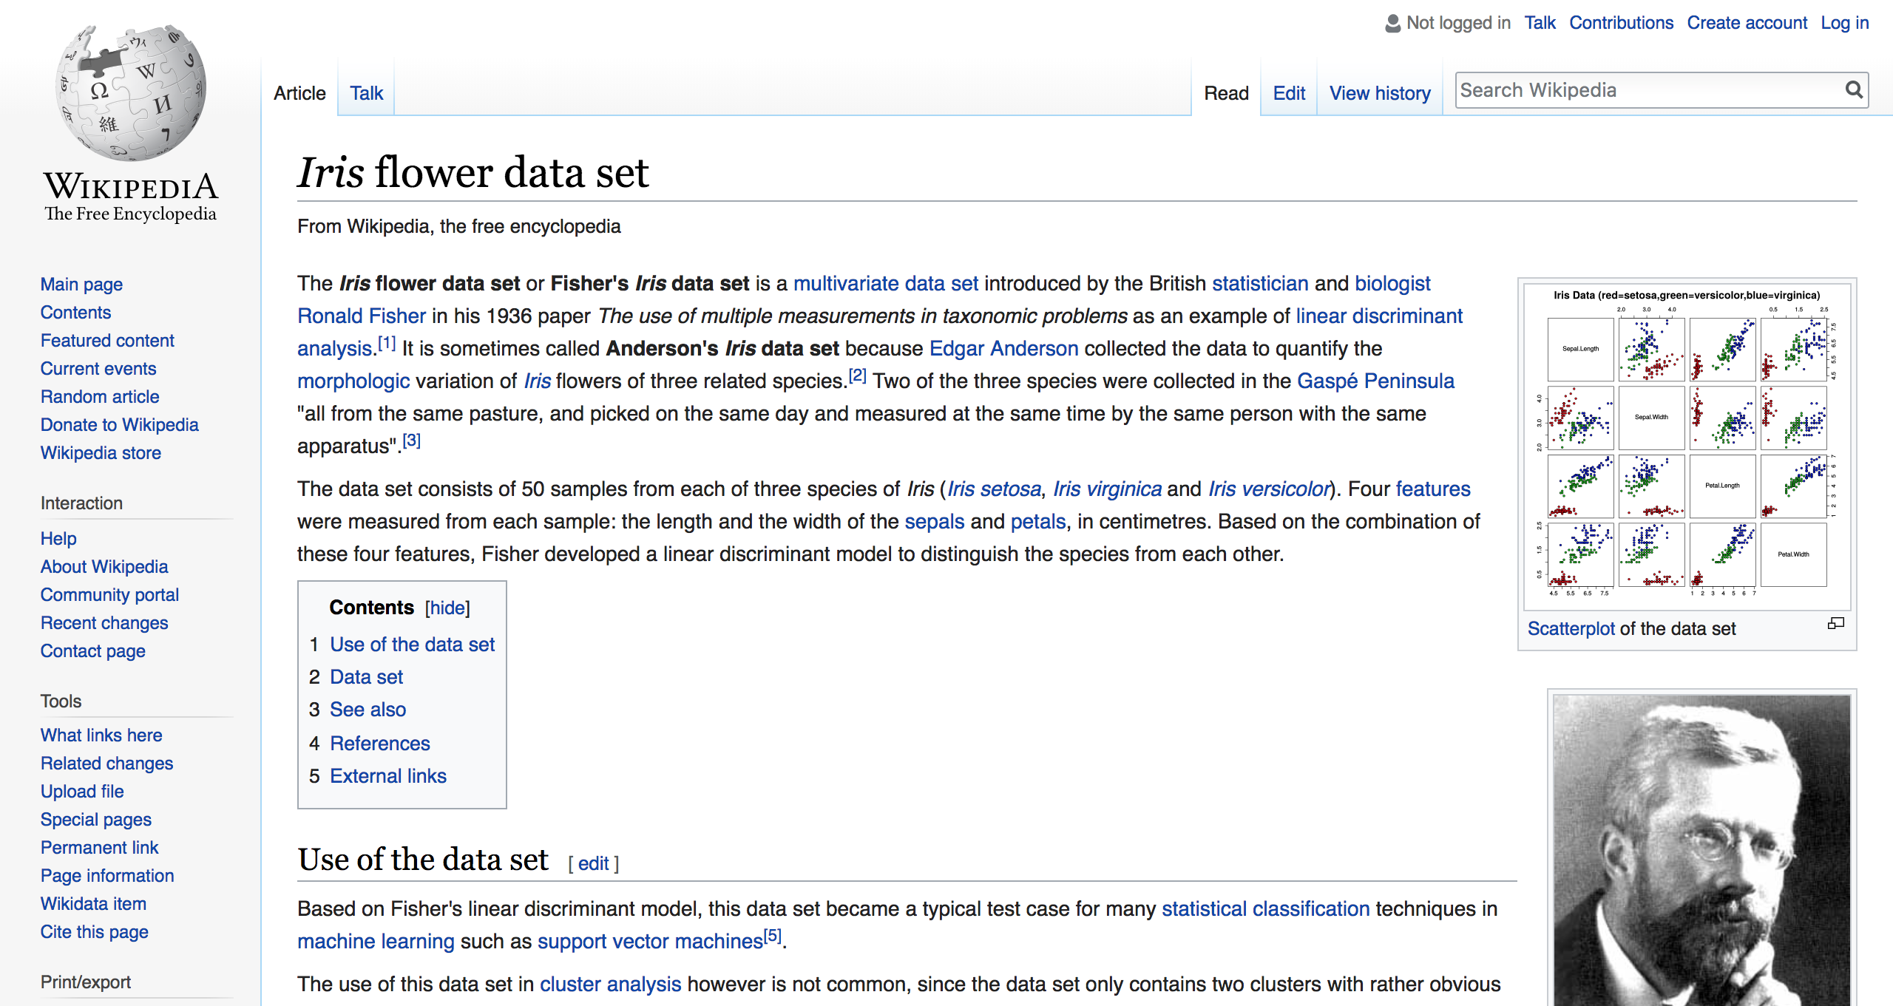
MCB 293S
Exploratory
Data Analysis
Data Visualization
Week 1

Slide 27
Data Visualization
How to represent different types of information

Slide 28
Thoughts
Data changes.
The types of data we work with today are different from the types of data people were interested in 20 year ago. This will also be true 20 years from now. We need to build up a set of tools that will continue to be useful, so that we can adapt.
Look at your data.
Understanding the experiment and understanding the data are different. It is important to spend time “getting to know” your data, so that you understand what it’s telling you (or not telling you).
Pictures convince people.
As humans, we are much better at deriving meaning from images than numbers. A table has never changed my mind about anything.
MCB 293S
Exploratory
Data Analysis
Data Visualization
Week 1

Slide 29
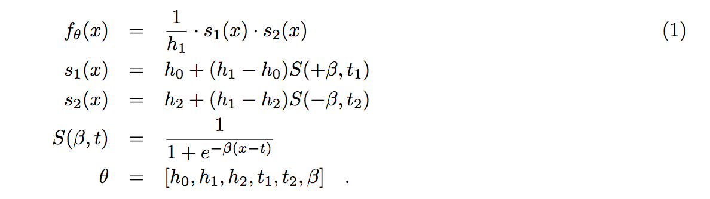
Storytelling
Impulse Model:
Chechik G, Koller D. Timing of gene expression responses to environmental changes. J Comput Biol. 2009;16(2):279–90. doi: 10.1089/cmb.2008.13TT.
MCB 293S
Exploratory
Data Analysis
Data Visualization
Week 1

Slide 30
Storytelling
GAM
FLAM
Ashley Petersen, Daniela Witten, and Noah Simon. Fused lasso additive model. Journal of Computational and Graphical Statistics, forthcoming.
MCB 293S
Exploratory
Data Analysis
Data Visualization
Week 1

Slide 31
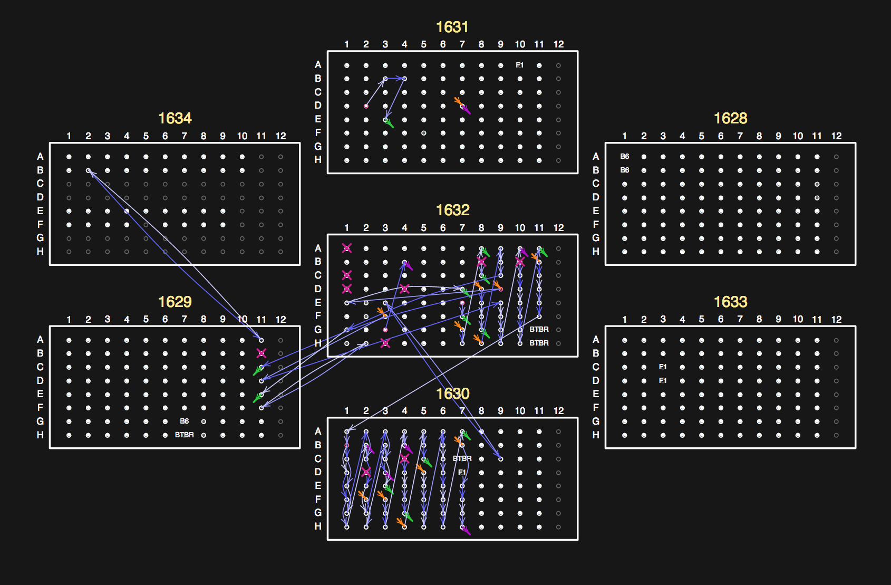
Information Density
https://www.biostat.wisc.edu/~kbroman/presentations/berkeley2017.pdf
MCB 293S
Exploratory
Data Analysis
Data Visualization
Week 1

Slide 32
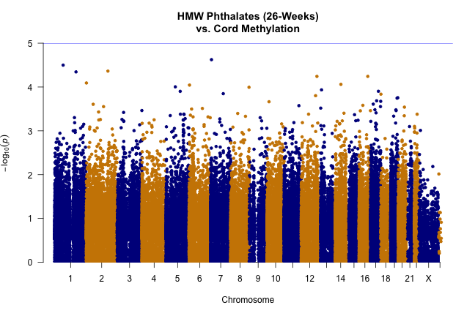
Information Density
MCB 293S
Exploratory
Data Analysis
Data Visualization
Week 1

Slide 33
Information Density
Pseudotime
MCB 293S
Exploratory
Data Analysis
Data Visualization
Week 1

Slide 34
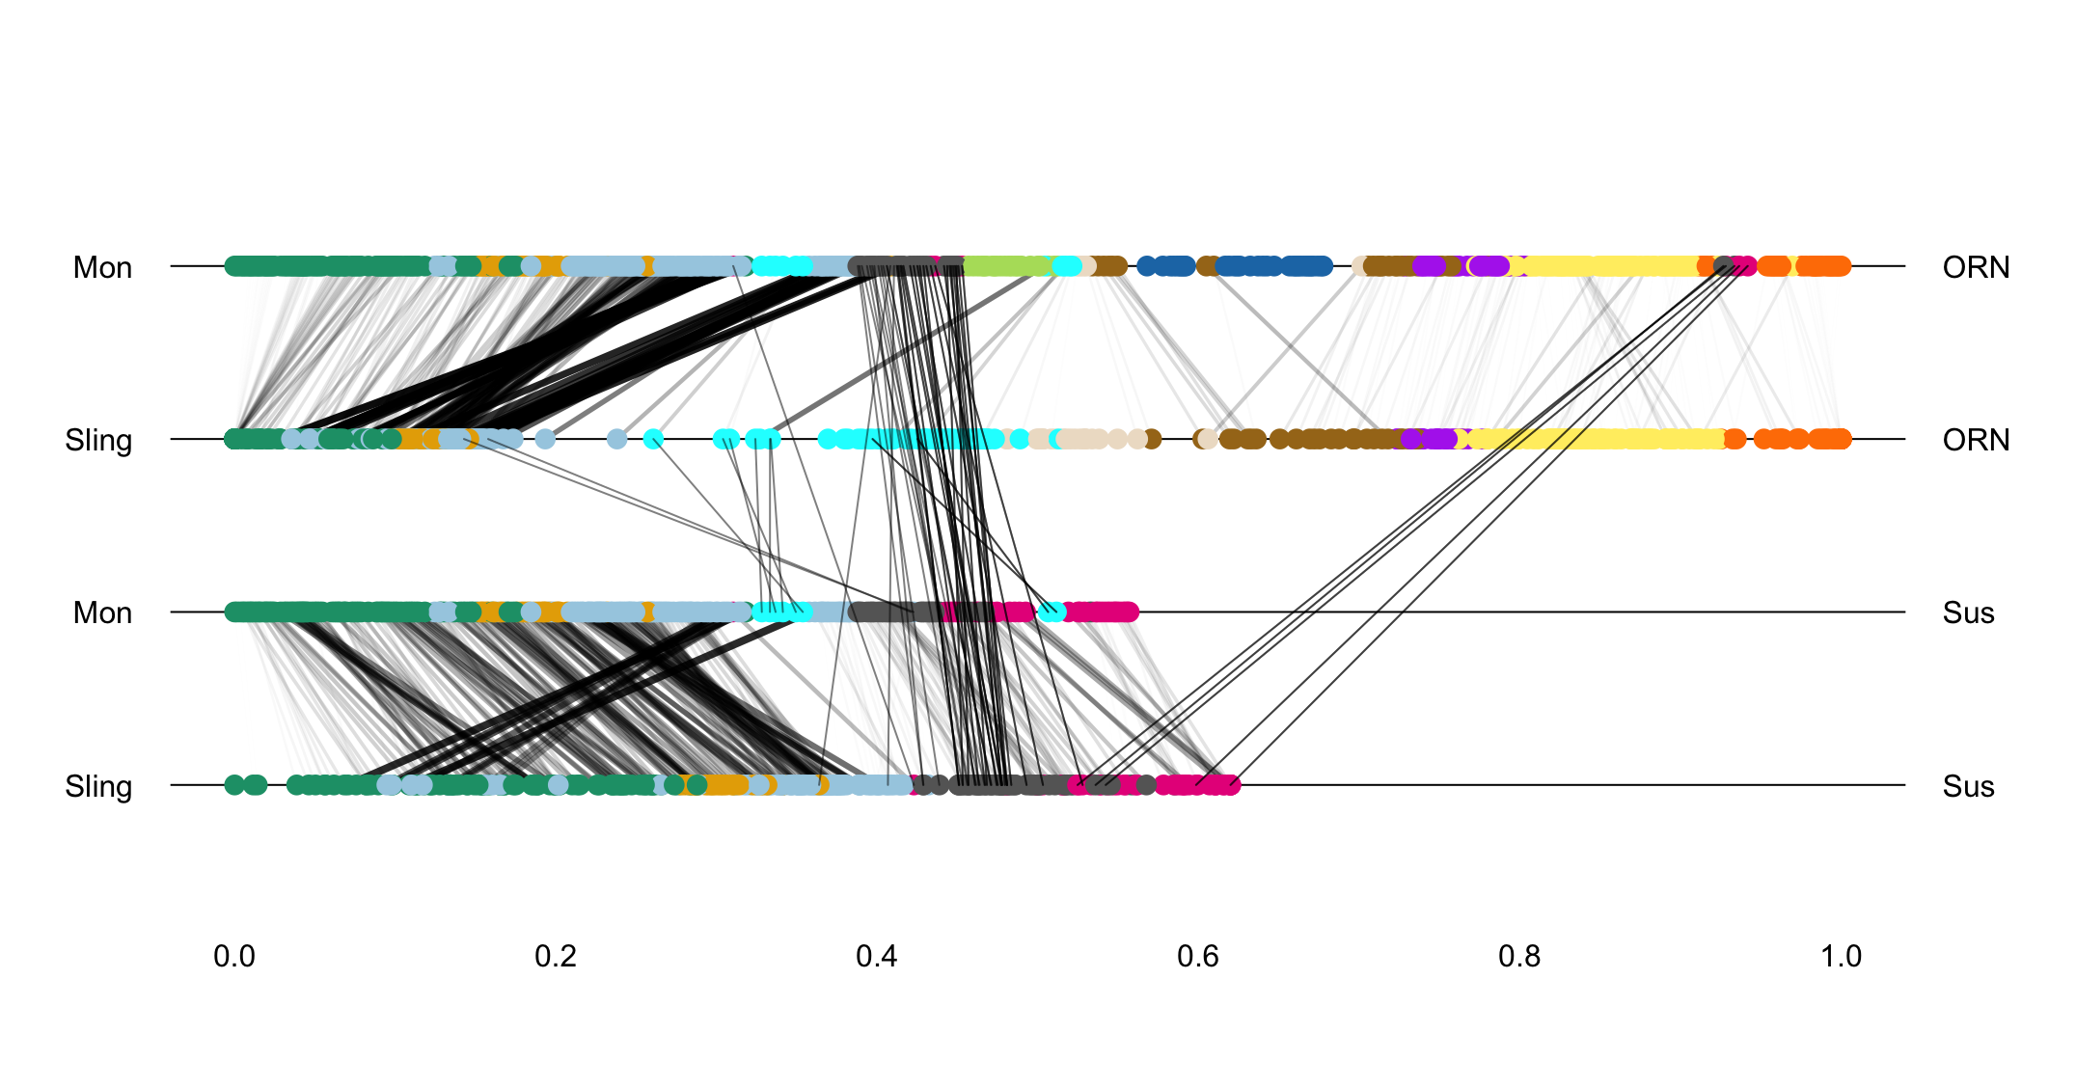
What was I thinking?
MCB 293S
Exploratory
Data Analysis
Data Visualization
Week 1

Slide 35
It’s a process…
MCB 293S
Exploratory
Data Analysis
Data Visualization
Week 1

Slide 36
Types of Data
binary
ordinal
circular
continuous
categorical
MCB 293S
Exploratory
Data Analysis
Data Visualization
Week 1

Slide 37
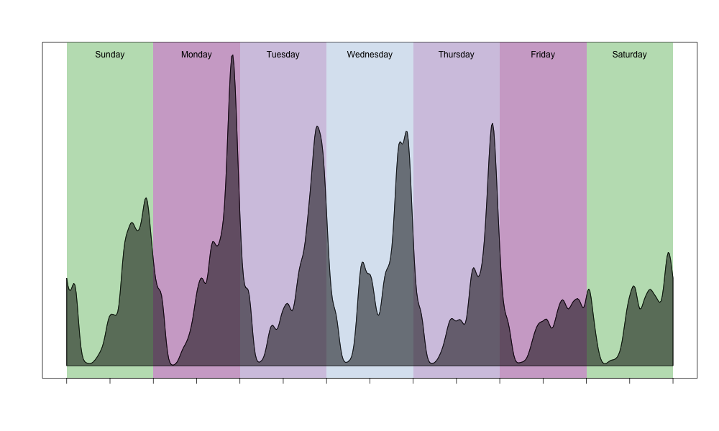
Types of Data
MCB 293S
Exploratory
Data Analysis
Data Visualization
Week 1

Slide 38
Types of Data
continuous
MCB 293S
Exploratory
Data Analysis
Data Visualization
Week 1

Slide 39
Types of Data
Stacked
Bar Plot
Bar Plot
categorical
MCB 293S
Exploratory
Data Analysis
Data Visualization
Week 1

Slide 40
Types of Data
X:
x
Y:
MCB 293S
Exploratory
Data Analysis
Data Visualization
Week 1

Slide 41
Types of Data
X:
x
Y:
x
Z:
MCB 293S
Exploratory
Data Analysis
Data Visualization
Week 1

Slide 42
Types of Data
Samples
(~100)
Genomics
Genes
(~20,000)
MCB 293S
Exploratory
Data Analysis
Data Visualization
Week 1

Slide 43
Types of Data
X₂
X₁
Graphs/
Networks
X₃
X₆
X₄
X₅
X₈
X₇
MCB 293S
Exploratory
Data Analysis
Data Visualization
Week 1

Slide 44
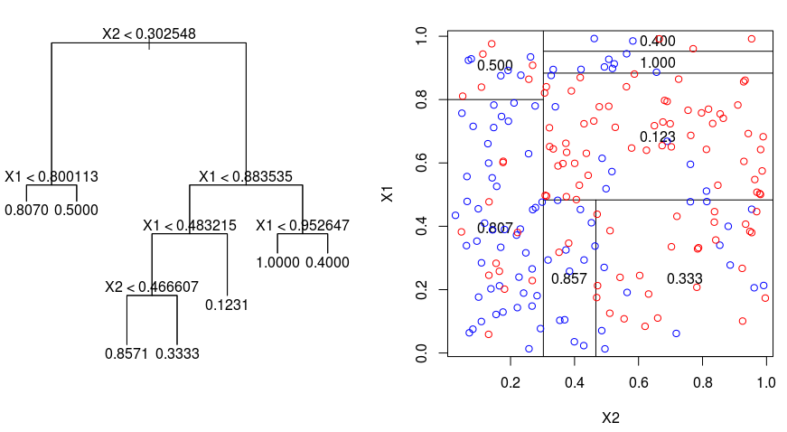
Hierarchical
MCB 293S
Exploratory
Data Analysis
Data Visualization
Week 1

Slide 45
Combination
Pseudotime
MCB 293S
Exploratory
Data Analysis
Data Visualization
Week 1

Slide 46
Show the data
Average
or
?
MCB 293S
Exploratory
Data Analysis
Data Visualization
Week 1

Slide 47
Show the data
Average
or
or
MCB 293S
Exploratory
Data Analysis
Data Visualization
Week 1

Slide 48
Thoughts
Data changes.
The types of data we work with today are different from the types of data people were interested in 20 year ago. This will also be true 20 years from now. We need to build up a set of tools that will continue to be useful, so that we can adapt.
Look at your data.
Understanding the experiment and understanding the data are different. It is important to spend time “getting to know” your data, so that you understand what it’s telling you (or not telling you).
Pictures convince people.
As humans, we are much better at deriving meaning from images than numbers. A table has never changed my mind about anything.
MCB 293S
Exploratory
Data Analysis
Data Visualization
Week 1

